Slide 1
CSE 203: Data Structures
Lecture 4: Elementary Data Structures- Queue

Slide 2


Queues
FIFO: First in, First Out
Restricted form of list: Insert at one end, remove from the other.
Notation:
Insert: Enqueue
Delete: Dequeue
First element: Front
Last element: Rear

Slide 3
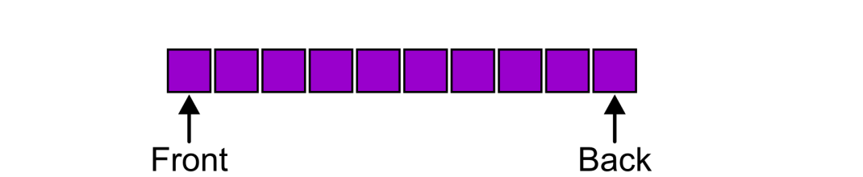
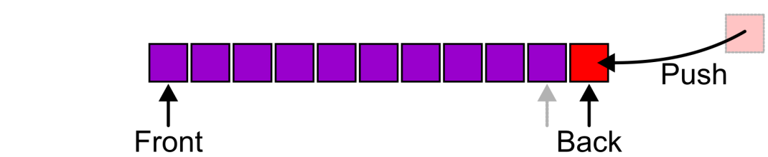
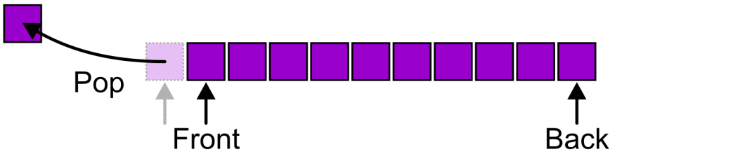
Abstract Queue
Also called a first-in–first-out (FIFO) data structure
Graphically, we may view these operations as follows:
head
tail
rear
Enqueue
Dequeue
Notes:
Alternative terms are also shown here: front – head; back = tail.

Slide 4
Abstract Queue
There are two exceptions associated with abstract Queue data structure:
It is an undefined operation to call either pop or front on an empty queue

Slide 5
Queue ADT in C++

Slide 6
Array Based Implementation
The array-based queue is somewhat tricky to implement effectively.
A simple conversion of the array-based list implementation is not efficient.
Why?

Slide 7
Array Based Implementation
Assume that there are n elements in the queue and Like our list implementation, we require that all elements of the queue be stored in the first n positions of the array.
Impl. 1:
The rear element of the queue is at position 0,
dequeue operations require only O(1) time because the front element of the queue is the last element in the array.
front
rear
front
rear
front
rear
Notes:
Red one is going out.

Slide 8
Array Based Implementation
Assume that there are n elements in the queue and Like our list implementation, we require that all elements of the queue be stored in the first n positions of the array.
Impl. 1:
The rear element of the queue is at position 0,
However, enqueue operations will require O(n) time, because the n elements currently in the queue must each be shifted back.
front
rear
front
rear
front
rear
Notes:
Green one needs to go in…

Slide 10
Array Based Implementation
Assume that there are n elements in the queue and Like our list implementation, we require that all elements of the queue be stored in the first n positions of the array.
Impl. 2:
The rear element of the queue is at position n-1,
then an enqueue operation is equivalent to an append operation on a list. This requires only O(1) time.
rear
front
rear
front
rear
front
Notes:
Red one is going out.

Slide 11
Array Based Implementation
Assume that there are n elements in the queue and Like our list implementation, we require that all elements of the queue be stored in the first n positions of the array.
Impl. 1:
The rear element of the queue is at position 0,
But now, a dequeue operation requires O(n) time, because all of the elements must be shifted down by one position.
rear
front
rear
front
rear
front
Notes:
Green one needs to go in…

Slide 12
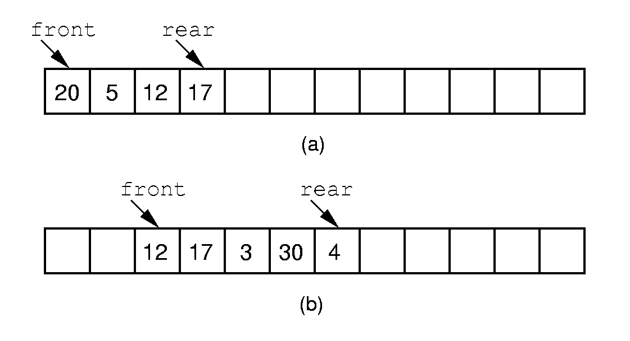
Solution: Queue Implementation (1)
(a) Gives the Queue after 20, 5, 12, 17 are enqueued initially. (b) Gives Queue after 20 and 5 are dequeued and 3, 30, 4 are enqueued.
Notes:
If we stick to the requirement that the queue elements be at the beginning n elements of the array, then either enqueue or dequeue must be θ(n).
Better is to let the elements “drift” within the array.
Unfortunately, as items are added and removed, the queue “drifts” toward the end. Eventually, there will be no space to the right of the queue, even though there is space in the array.

Slide 13
Performance
Enqueue: O(1)
Dequeue: O(1)
Drifting Queue problem:
Dequeue => the front index increases.
Over time, the entire queue will drift toward the higher-numbered positions in the array.
Once an element is inserted into the highest-numbered position in the array, the queue has run out of space.
This happens despite the fact that there might be free positions at the low end of the array where elements have previously been removed from the queue.

Slide 14
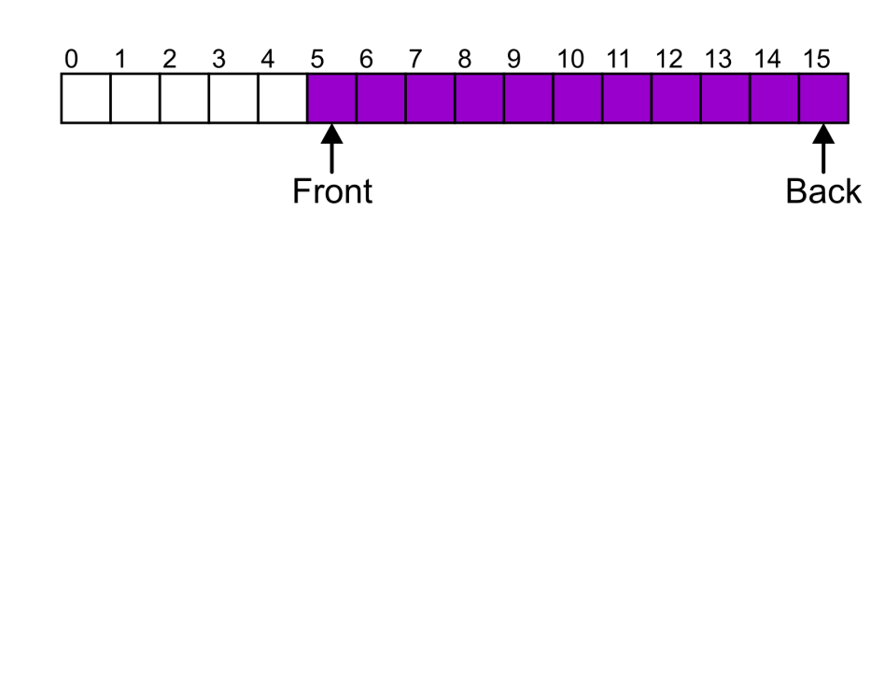
Drifting Queue Problem
Suppose that:
The array capacity is 16
We have performed 16 pushes
We have performed 5 pops
The queue size is now 11
We perform one further push
In this case, the array is not full and yet we cannot place any more objects in to the array
Notes:
14

Slide 15
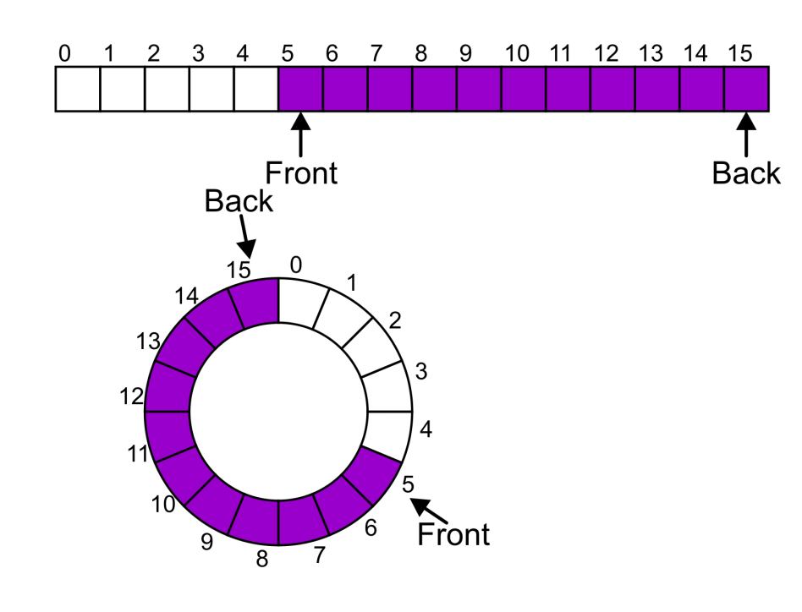
Solution to Drifting Queue Problem: Implementation (2)
Instead of viewing the array on the range 0, …, 15, consider the indices being cyclic:
…, 15, 0, 1, …, 15, 0, 1, …, 15, 0, 1, …
This is referred to as a circular array
Notes:
15

Slide 16
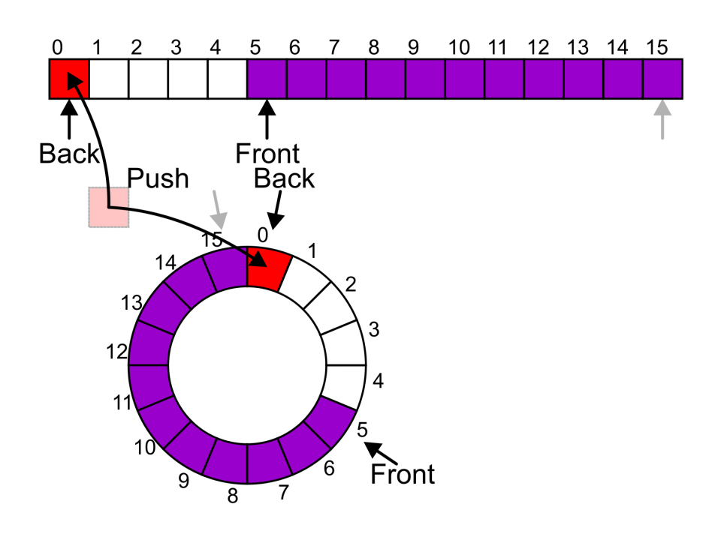
Solution to Drifting Queue Problem: Implementation (2)
push => enqueu
Now, the next push may be performed in the next available location of the circular array:
Notes:
16

Slide 17
Implementation
We allow the queue to continue directly from the highest-numbered position in the array to the lowest-numbered position.
This is easily implemented through use of the modulus operator (denoted by % in C++).
positions in the array are numbered from 0 through size-1,
and position size-1 is defined to immediately precede position 0
(which is equivalent to position size % size).

Slide 18
One Subtle Issue
front
How can we recognize when the queue is empty or full?
front = rear?
This means one element is there.
rear = front -1?
Seems a solution.
What happens when the queue is full?
0
1
2
3
4
rear
12
5
front
11
9
8
7
6
0
1
2
3
4
12
5
rear
front
11
9
8
7
6
front
0
1
2
3
4
0
1
2
3
4
12
5
12
5
11
9
8
7
6
rear
11
9
8
7
6
rear

Slide 19
A strange proof
front
We can in fact prove that we cannot solve the above issue by changing the definition of front and rear
Assume front is fixed.
We can have n values of rear
But we can have n+1 possible states of the queue
Pigeon hole principle=> one value of rear must be mapped to 2 different states!!!
0
1
2
3
4
12
5
rear
11
9
8
7
6
front
0
1
2
3
4
12
5
rear
11
9
8
7
6
2 different states for the same value of rear

Slide 20
Two Solutions
keep an explicit count of the number of elements in the queue, or at least a Boolean variable that indicates whether the queue is empty or not.
Another solution is to make the array be of size n + 1, and only allow n elements to be stored.
We use the second one…

Slide 21
front
front
rear
0
1
2
3
4
0
1
2
3
4
rear
12
empty
5
12
First enqueue
5
11
9
8
7
6
11
9
8
7
6
front
front
0
1
2
3
4
0
1
2
3
4
rear
12
full
5
12
7 enqueues done
5
11
9
8
7
6
11
9
8
7
6
rear

Slide 22
Array implementation of Queue

Slide 23
Linked List Implementation of Queue
We will use a header link node, which allows for a simpler implementation of the enqueue operation by avoiding any special cases when the queue is empty.
On initialization, the front and rear pointers will point to the header node, and front will always point to the header node while rear points to the true last link node in the queue.
Method enqueue places the new element in a link node at the end of the linked list (i.e., the node that rear points to) and then advances rear to point to the new link node.
Method dequeue removes and returns the first element of the list.

Slide 24
Linked List Implementation of Queue
There is a small mistake in clear()
rear = front => rear = front-next

